Slide 1
Best Practice
Query Evaluation
Practical Query Developing Strategies
Database Management Systems

Slide 2

Introduction
Alternative ways of evaluating a given query
  Equivalent expressions
  Different algorithms for each operation

Slide 3

Introduction (Cont.)
An evaluation plan defines exactly what algorithm is used for each operation, and how the execution of the operations is coordinated.
Find out how to view query execution plans on your favorite database

Slide 4
Introduction (Cont.)
Cost difference between evaluation plans for a query can be enormous
  E.g. seconds vs. days in some cases
Steps in cost-based query optimization
  Generate logically equivalent expressions using equivalence rules
  Annotate resultant expressions to get alternative query plans
  Choose the cheapest plan based on estimated cost
Estimation of plan cost based on:
  Statistical information about relations. Examples:
    number of tuples, number of distinct values for an attribute
  Statistics estimation for intermediate results
    to compute cost of complex expressions
  Cost formulae for algorithms, computed using statistics

Slide 5
Know Your Data
Most of the time you work on databases created by other people. The best way to start with is to:
Get familiar with the data you are working on by all means
Print a number of lines of data from tables on paper, one table on each page (database on paper)
Find interconnections (links) between tables
Try to memorize major tables names, sizes, some values, and data types (metadata in head)
Identify possible primary keys & other keys
Start building queries with small amount of data
Database Management Systems

Slide 6
Sharpen your SQL skill
Knowing SQL syntax inside out will help you write your queries faster with fewer errors.
Know the SQL native to the environment you are working on.
SELECT, FROM, WHERE, ORDER BY, JOIN, LEFT/RIGHT OUTER JOIN, AND, OR, NOT, IN, LIKE, EXISTS, UNION, SUM, COUNT, AVG, MIN, MAX, GROUP BY, HAVING……
Database Management Systems

Slide 7
Use “Join” Effectively
A relational database’s power is its ability to store related data across many tables. This requires retrieving data from multiple tables by joining them. These are the mostly used joins:
Inner Join
Left Outer Join
Right Outer Join
Full Outer Join
Natural Join
“Self” Join
Database Management Systems

Slide 8
Use Fully Qualified Object Names
Use fully qualified database object names as much as you can. This helps you find where the object is in one or multiple large databases. For example:
SELECT *
FROM server.database.schema.table
In Oracle, limit the use of synonyms.
Database Management Systems

Slide 9
Use of Data Dictionary (Metadata)
Data dictionary, or metadata repository, contains your database’s metadata, the data of data. It is like a treasure map with which you can find valuable information. Without it, you are like the blind men learning the elephant by touching.
Not every user has high level access to data dictionary. Use whatever you can to find things.
Database Management Systems

Slide 10
Know Database Permissions
Data dictionary may not tell you everything because of your access level. A good useful table is right out there, but you may not even know its existence.
Your DBA is your best helper. You should use your DBA as a guide.
Database Management Systems

Slide 11
Know Your DBMS Limitations
Databases are powerful tools, however, they are not without limitations. Oracle, SQL Server, and MySQL all have unique limitations on things such as maximum database sizes, maximum number of tables, and others.
If one way doesn’t work, find alternative ways. For example, use subquery to get full outer join in MySQL.
Database Management Systems

Slide 12
Best Practice
Optimize your SQL Queries using Indexes
Database Management Systems

Slide 13
Use Indexes Smartly
Creating proper indexes is the easiest way (and maybe the best as well) you can improve the performance of your SQL queries. A simple index can cut execution time from hours or even days down to seconds.
Still, you should have created a good query to start with.
Database Management Systems

Slide 14
Delete/Update Using Index
Indexes generally make deletions slow. But, for a large table, you can save time by creating an index on the predicate columns of the deletion.
This is because deletion acts like “seek & mark-for-deletion”. Fast search means fast deletion. Disable index “auto rebuild” if possible. Commit only after a complete set is done.
After deletion is committed, rebuild indexes or simply drop/re-create indexes. For update, operation on indexes is not needed after commit.
Database Management Systems

Slide 15
Insertion and Index
Indexes are very negative to insertion. The best practice is to drop or disable the indexes until all insert operations are done and committed, then re-create or enable/rebuild the indexes. Especially useful in case of large insertions.
Database Management Systems

Slide 16
Sort Using Index
Large tables need a long time to sort (using ORDER BY clause).
Creating an index before sorting can save time.
Database Management Systems

Slide 17
Using Views
Using views sometimes can save time. This is because some DBMS software use buffer cache to keep data blocks of recently run tables and views in the memory. If a SQL uses same tables or views, the speed can be very fast.
Database Management Systems

Slide 18
Only Retrieve Data Needed
Suppose table users has 50 columns. You may do the following query at testing or development stage:
SELECT * FROM users WHERE age > 20 LIMIT 10;
When it is turned to production, use this:
SELECT id, last_name, sex, age FROM users WHERE age > 20;
Database Management Systems

Slide 19
Avoid Functions in WHERE clauses
In WHERE clauses, Functions may result in major performance issues. For example:
SELECT nickname FROM users WHERE DATEDIFF(MONTH, appointment_date, '2015-04-28') < 0;
You should use this:
SELECT nickname FROM users WHERE appointment_date > '2015-04-30';
Database Management Systems

Slide 20
Avoid Triggers
Triggers are convenient ways to populate tables and keep data integrity in real time.
There are triggers for before/after update, deletion, and insertion.
Triggers work on either row level or table level
They are also performance hogs.
If you have to use triggers, try to make them short, with minimum amount of operations.
Database Management Systems

Slide 21
Use Correlated Subquery Wisely
A correlated subquery is a subquery depending on the outer query. It uses the data obtained from the outer query in its WHERE clause.
SELECT user_id, last_name FROM users WHERE EXISTS (SELECT * FROM donationuser WHERE user_id = users.user_id);
Replace above with Self-join (in some cases):
SELECT DISTINCT users.user_id FROM users u INNER JOIN donationuser d ON u.user_id = d.user_id;
Database Management Systems

Slide 22
Avoid Wildcard LIKE Operator
Whenever possible, avoid using the LIKE pattern in the following way:
SELECT * FROM users WHERE name LIKE '%bar%';
Instead use:
SELECT * FROM users WHERE name LIKE 'bar%';
Database Management Systems

Slide 23
Best Practice
Using Explain
Database Management Systems

Slide 24
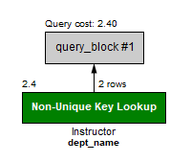
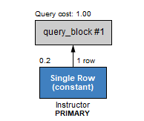
Use Explain to find query plan
Whenever possible, use indexed attributes in the where clause.
Table: Instructor Index on ID
Select * from Instructor
where dept_name = 'Physics’;
Select * from Instructor where ID = ‘22222’;
Database Management Systems

Slide 25
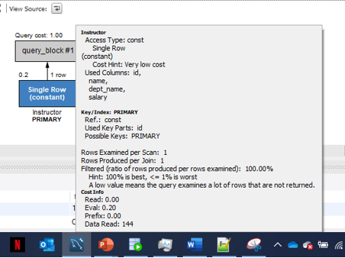
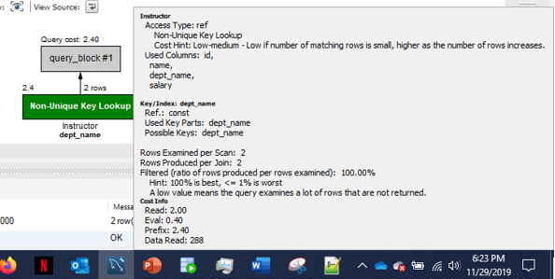
Use Explain to find query plan
Whenever possible, use indexed attributes in the where clause.
Table: Instructor Index on ID
Select * from Instructor
where dept_name = 'Physics’;
Select * from Instructor where ID = ‘22222’;
Database Management Systems

Slide 26
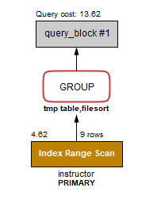
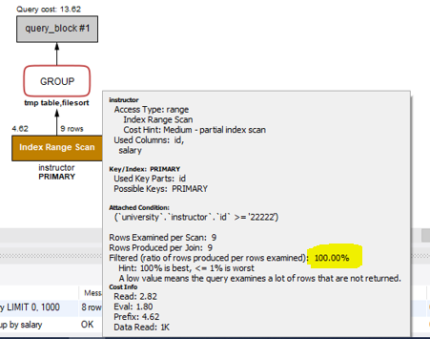
Use Explain to find query plan
Query plan for Group By:
SELECT salary, count(*)
FROM instructor
WHERE ID >= '22222’
GROUP BY salary;
Database Management Systems

Slide 27
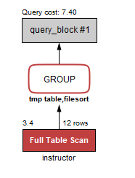
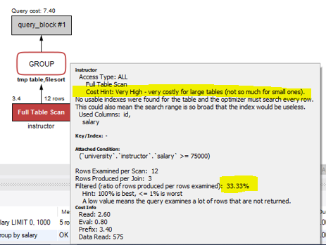
Use Explain to find query plan
Query plan for Group By:
SELECT salary, count(*)
FROM instructor
WHERE salary >= 75000
GROUP BY salary;
Database Management Systems

Slide 28
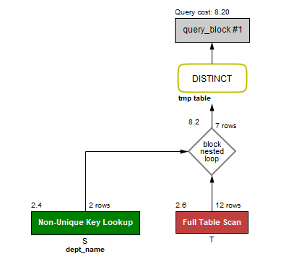
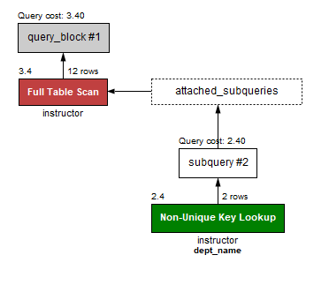
Use Explain to find query plan
Subquery vs Join
select name
from instructor
where salary >
some (select salary
from instructor
where dept_name =
‘History’);
select distinct T.name
from instructor T, instructor S
where T.salary > S.salary and S.dept_name = ‘History’;
Database Management Systems

Slide 29
Upgrade you hardware
For example, memory can improve your query performance significantly. Modern DBMS can cache data in memory buffer for quick retrieval.
For example, disk block fetch requires about 5 to 10 milliseconds, versus about 100 nanoseconds for memory access.
Database Management Systems

Slide 30
Materialized View
A materialized view is a database object that contains the results of a query. For example, it may be a local copy of data located remotely, or may be a subset of the rows and/or columns of a table or join result, or may be a summary using an aggregate function.
Materialized view is an Oracle terminology. In SQL Server, an indexed view is used for the same purpose.
Database Management Systems

Slide 31
Query Analyzer, Optimizer, Advisor, Tuner, etc.
Many DBMS environments provide some kind of Query Optimizers. Take advantage of it.
In SQL Server, it is called “SQL Query Analyzer”;
In Oracle, it is called “SQL Tuning Advisor”;
In MySQL, it is called “MySQL query optimizer”???
Database Management Systems

Slide 32
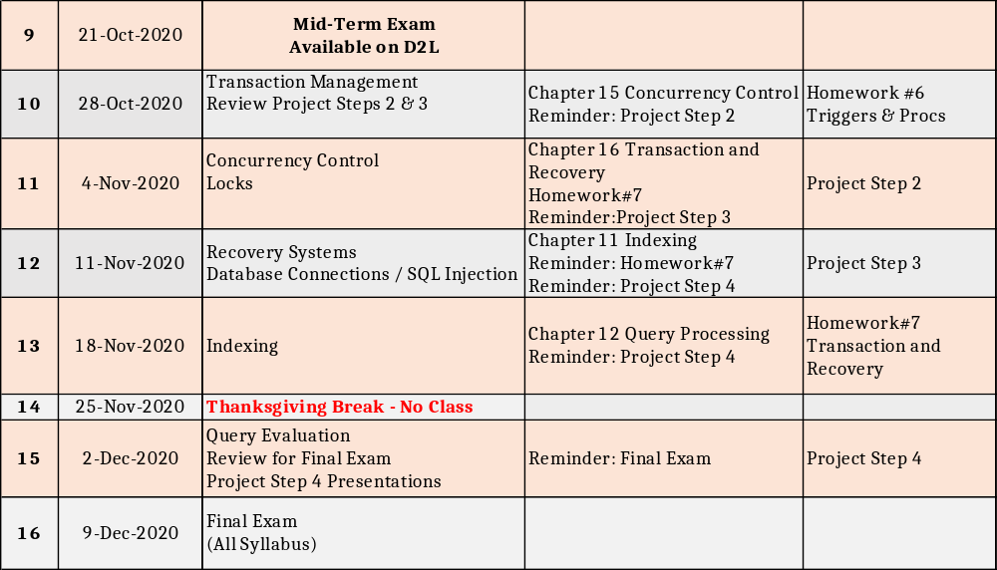
Reading and Assignment
No. | Date | Topics and Required Reading | Assignments
 |  |  |  | start of class day

